Slide 1


AI BASED DIABETES PREDICTION SYSTEM
DEPARTMENT OF ELECTRONICS AND COMMUNICATION ENGINEERING
TEAM MEMBERS:
SIRIGIRI.VAMSI KRISHNA (113321106089) SATHISH N (113321106087)
VISHNU VARDHAN.S (113321106081)
GOWTHAM.V (113321106111)
TEAM NAME:
Proj_224828_Team_2

Slide 2
PROBLEM DEFINITION
There are several challenges and potential problems associated with AI
based diabetes prediction systems:
AI models require high-quality and diverse data for accurate predictions. Inconsistent or biased data can lead to inaccurate results and may not reflect the true complexity of diabetes.
AI models can inherit biases present in the data they are trained on, which may result in unfair predictions, especially if the data is not representative of all demographics.
AI models may struggle to generalize to new, unseen data, which can limit their effectiveness in real-world scenarios.
Privacy and data security are significant concerns when dealing with medical data. Protecting patients' information and complying with regulations like HIPAA is essential.
Interpretability: AI models can be complex "black boxes," making it difficult for healthcare professionals to understand and trust their predictions.Cost: Implementing and maintaining AI-based systems can be costly, which may limit their accessibility to some healthcare providers.

Slide 3
OBJECTIVES
The objective of an AI-based diabetes prediction system is to accurately identify individuals at risk of developing diabetes or to predict future complications in diabetic patients. This system aims to:
Early Detection: Detect diabetes or pre diabetes in individuals before clinical symptoms appear, allowing for early intervention and lifestyle modifications.
Risk Assessment: Evaluate the risk factors and susceptibility of individuals to diabetes based on various data inputs such as medical history, genetics, lifestyle, and biomarkers.
Personalized Medicine: Provide personalized recommendations and interventions for diabetes prevention or management based on an individual's unique profile.
Improve Healthcare Planning: Assist healthcare providers in identifying high-risk populations, allocating resources efficiently, and tailoring diabetes prevention and treatment strategies.
Enhance Patient Care: Improve patient outcomes by enabling timely interventions, monitoring, and management of diabetes-related complications.
Data-Driven Insights: Generate valuable insights from large datasets to better understand the factors contributing to diabetes and its progression.
Ultimately, the goal is to use AI to enhance diabetes prevention, management, and overall healthcare outcomes by leveraging advanced analytics and predictive modeling techniques.

Slide 4
PROPOSE SYSTEM
An AI-based diabetes prediction system involves several key components and steps:
Data Collection: Gather a comprehensive dataset of individuals, including their medical history, lifestyle factors, and diabetes-related information (e.g., blood glucose levels, family history).
Data Preprocessing: Clean and preprocess the data to handle missing values, outliers, and ensure data quality.
Feature Selection/Engineering: Identify relevant features and perform feature selection or engineering to enhance model performance.
Model Selection: Choose appropriate machine learning or deep learning algorithms for prediction, such as logistic regression, decision trees, random forests, or neural networks.
Training: Split the dataset into training and testing sets to train the AI model on historical data.
Model Tuning: Optimize hyperparameters and fine-tune the model to achieve the best performance.
Validation: Assess the model's accuracy, sensitivity, specificity, and other relevant metrics using cross-validation or other validation techniques.
Interpretability: Ensure that the model's predictions can be interpreted by clinicians and end-users to build trust and transparency.
Integration: Develop a user-friendly interface or API that allows healthcare professionals or patients to input relevant data for predictions.
Ethical Considerations: Address ethical concerns related to AI in healthcare, such as bias, fairness, and accountability.

Slide 5
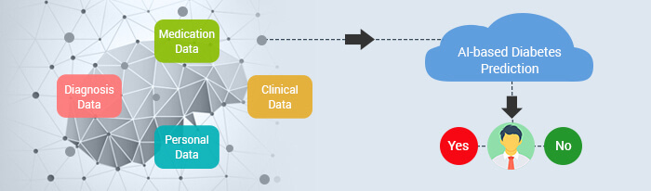
AI BASED DIABETES PREDICTION SYSTEM DESIGN

Slide 6
REAL TIME TRANSMIT PLATFORM
Data Integration: Collect real-time data from various sources such as wearable devices, electronic health records (EHRs), and patient inputs.
Data Processing: Continuously preprocess and clean incoming data to ensure consistency and reliability.
Feature Extraction/Engineering: Extract relevant features from real-time data and combine them with historical data for prediction.
AI Model: Implement a machine learning or deep learning model capable of handling real-time data streams. Recurrent Neural Networks (RNNs) or Transformers can be suitable for sequential data like glucose measurements.
Model Deployment: Deploy the AI model on a scalable and robust platform, such as cloud infrastructure or edge devices, to handle real-time predictions.
Real-time Data Stream: Set up a data pipeline that can handle real-time data streams efficiently. Tools like Apache Kafka or AWS Kinesis can help with data streaming
Prediction Engine: Continuously feed incoming data into the AI model to make predictions in real-time.
Thresholds and Alerts: Establish thresholds for diabetes risk levels, and trigger alerts or notifications when a high-risk prediction is made.

Slide 7
PROPOSED SYSTEM
This section describes the working procedures and implementation of various machine learning techniques to design the proposed automatic diabetes prediction system.
From the figure, shows the different stages of this research work. First, the dataset was collected and preprocessed to remove the necessary discrepancies from the dataset, for example, replacing null instances with mean values, dealing with imbalanced class issues etc.
Then the dataset was separated into the training set and test set using the holdout validation technique. Next, different classification algorithms were applied to find the best classification algorithm for this dataset.
Finally, the best‐performed prediction model is deployed into the proposed website and smartphone application framework.

Slide 8
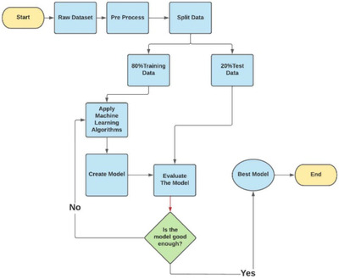

Slide 9
DEPLOYMENT OF PREDICTION SYSTEM
The proposed machine learning‐based diabetes prediction system has been deployed into a website and smartphone application framework to work instantaneously on real data.
Web application: We have used HTML and CSS for the frontend part of the proposed website. After that, we finalized the machine learning model XGBoost with ADASYN, as it provided the best performance. The model deployment has been done with Spyder, a Python environment platform that works with Anaconda.
From the figure , shows the illustration of the website application development process.

Slide 10
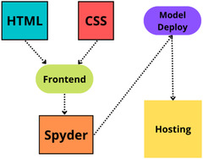
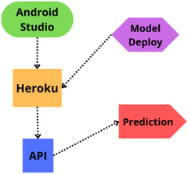
Android smartphone application: To demonstrate the automatic diabetes forecasting system in real time, we also designed an Android smartphone application to test its performance. Android Studio is used for the frontend part of this application. We employed Java as the necessary coding language. After that, the model has been implemented in Android Studio using the pickle package. While developing the API, we used Heroku to host our model on the corresponding hosting server. demonstrates the necessary steps in developing the proposed Android application

Slide 11
IOT BASED PROJECTS IN AI
Introduction
The technologies of the Internet of objects and their applications have made a great development by becoming in these days more accessible and more available, allowing a large number of objects to be interconnected via the Internet in several fields that are the field of health, home automation, industrial
manufacturing, etc [1]. In the field of intelligent health, there are several applications that aim to improve care and improve the quality of life of patients with chronic diseases. Using IoT, the mobile health service becomes more important as it plays a very important role in monitoring and controlling patients
who suffer from chronic diseases such as cardiovascular disease and diabetes [2][3]. In the field of intelligent health and more precisely in the part of patient monitoring, we find that patient data is very useful. Indeed to realize an IoT application in this field, the one must have assured the recording of a large amount of data collected by using measurements of the medical signs on the patients.

Slide 12
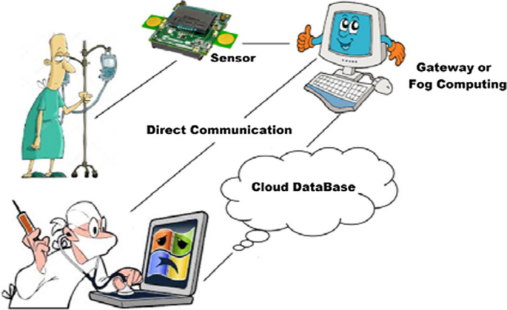
IOT DEVICE BLOCK DIAGRAM

Slide 13
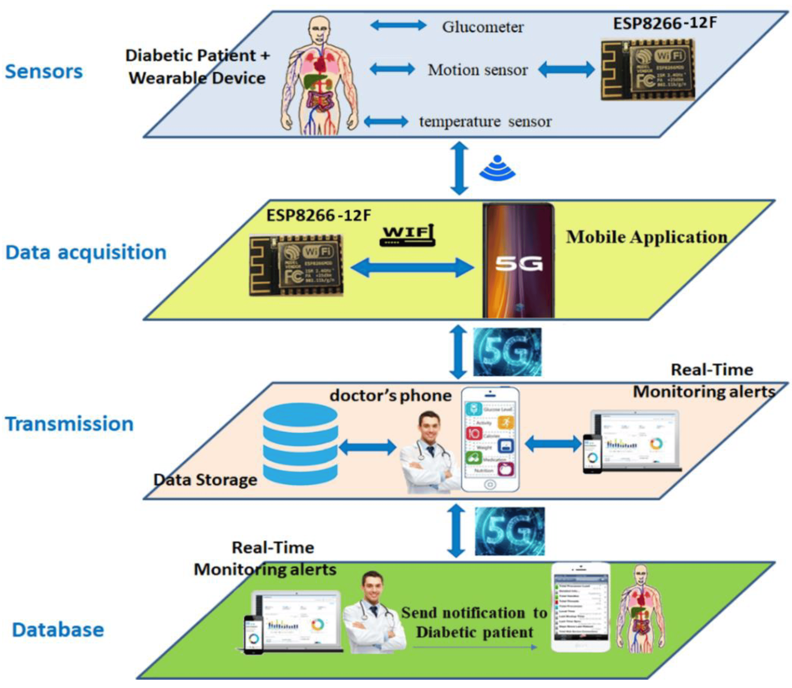
IOT SENSORS FOR AI PREDICTOON SYSTEM

Slide 14
MODULE 1:
INTRODUCTION :
In diabetes prediction system, We are going to Find human health function as follow,
Pregnancies: Number of times pregnant
Glucose: Plasma glucose concentration a 2 hours in an oral glucose tolerance test
BloodPressure: Diastolic blood pressure (mm Hg)
SkinThickness: Triceps skin fold thickness (mm)
Insulin: 2-Hour serum insulin (mu U/ml)
BMI: Body mass index (weight in kg/(height in m)^2)
DiabetesPedigreeFunction: Diabetes pedigree function
Age: Age (years)
Outcome: Class variable (0 or 1)

Slide 15
PROGRAM :
import pandas as pd
import numpy as np
import matplotlib.pyplot as plt
import seaborn as sns
from sklearn.model_selection import train_test_split
from sklearn.preprocessing import StandardScaler
from sklearn import svm
from sklearn.metrics import classification_report
from sklearn.metrics import confusion_matrix
from sklearn.metrics import ConfusionMatrixDisplay
RED = "\033[91m"
GREEN = "\033[92m"
YELLOW = "\033[93m"
BLUE = "\033[94m"
RESET = "\033[0m"
​df = pd.read_csv("/kaggle/input/diabetes-data-set/diabetes.csv")
​
# DATA CLEANING
print(BLUE + "\nDATA CLEANING" + RESET)
# --- Check for missing values
missing_values = df.isnull().sum()
print(GREEN + "Missing Values : " + RESET)
print(missing_values)
# --- Handle missing values
mean_fill = df.fillna(df.mean())
df.fillna(mean_fill, inplace=True)
​
​

Slide 16
# --- Check for duplicate values
duplicate_values = df.duplicated().sum()
print(GREEN + "Duplicate Values : " + RESET)
print(duplicate_values)
# --- Drop duplicate values
df.drop_duplicates(inplace=True)
​
# DATA ANALYSIS
print(BLUE + "\nDATA ANALYSIS" + RESET)
# --- Summary Statistics
summary_stats = df.describe()
print(GREEN + "Summary Statistics : " + RESET)
print(summary_stats)
# --- Class Distribution
class_distribution = df["Outcome"].value_counts()
print(GREEN + "Class Distribution : " + RESET)
print(class_distribution)
# Support Vector Machine Modelling
print(BLUE + "\nMODELLING" + RESET)
X = df.drop("Outcome", axis=1)
y = df["Outcome"]
# --- Splitting the data into training and testing sets
X_train, X_test, y_train, y_test = train_test_split(
X, y, test_size=0.2, random_state=42
)

Slide 17
# --- Standardize Features
scaler = StandardScaler()
X_train = scaler.fit_transform(X_train)
X_test = scaler.transform(X_test)
# --- init and train SVM model
model = svm.SVC(kernel="linear")
model.fit(X_train, y_train)
# --- Predict on test data
y_pred = model.predict(X_test)
# --- Evaluate model performance
accuracy = model.score(X_test, y_test)
print(GREEN + "Model Accuracy : " + RESET)
print(accuracy)
# --- Classification Report and Confusion Matrix
print(GREEN + "Classification Report : " + RESET)
print(classification_report(y_test, y_pred))
print(GREEN + "Confusion Matrix : " + RESET)
cm = ConfusionMatrixDisplay.from_predictions(y_test, y_pred)
sns.heatmap(cm.confusion_matrix, annot=True, cmap="Blues")
plt.show()
print("Displayed")
# SAVING THE FILE
df.to_csv("/kaggle/working/cleaned_diabetes.csv", index=False)
print(BLUE + "\nDATA SAVING" + RESET)
print(GREEN + "Data Cleaned and Saved !" + RESET)

Slide 18
OUTPUT :
DATA CLEANING
Missing Values :
Pregnancies 0
Glucose 0
BloodPressure 0
SkinThickness 0
Insulin 0
BMI 0
DiabetesPedigreeFunction 0
Age 0
Outcome 0
dtype: int64
Duplicate Values :
0

Slide 19
DATA ANALYSIS
Summary Statistics :
Pregnancies Glucose BloodPressure SkinThickness Insulin \
count 768.000000 768.000000 768.000000 768.000000 768.000000
mean 3.845052 120.894531 69.105469 20.536458 79.799479
std 3.369578 31.972618 19.355807 15.952218 115.244002
min 0.000000 0.000000 0.000000 0.000000 0.000000
25% 1.000000 99.000000 62.000000 0.000000 0.000000
50% 3.000000 117.000000 72.000000 23.000000 30.500000
75% 6.000000 140.250000 80.000000 32.000000 127.250000
max 17.000000 199.000000 122.000000 99.000000 846.000000
BMI DiabetesPedigreeFunction Age Outcome
count 768.000000 768.000000 768.000000 768.000000
mean 31.992578 0.471876 33.240885 0.348958
std 7.884160 0.331329 11.760232 0.476951
min 0.000000 0.078000 21.000000 0.000000
25% 27.300000 0.243750 24.000000 0.000000
50% 32.000000 0.372500 29.000000 0.000000
75% 36.600000 0.626250 41.000000 1.000000
max 67.100000 2.420000 81.000000 1.000000
Class Distribution :
Outcome
0 500
1 268
Name: count, dtype: int64

Slide 20
MODELLING
Model Accuracy :
0.7597402597402597
Classification Report :
precision recall f1-score support
0 0.81 0.82 0.81 99
1 0.67 0.65 0.66 55
accuracy 0.76 154
macro avg 0.74 0.74 0.74 154
weighted avg 0.76 0.76 0.76 154

Slide 21
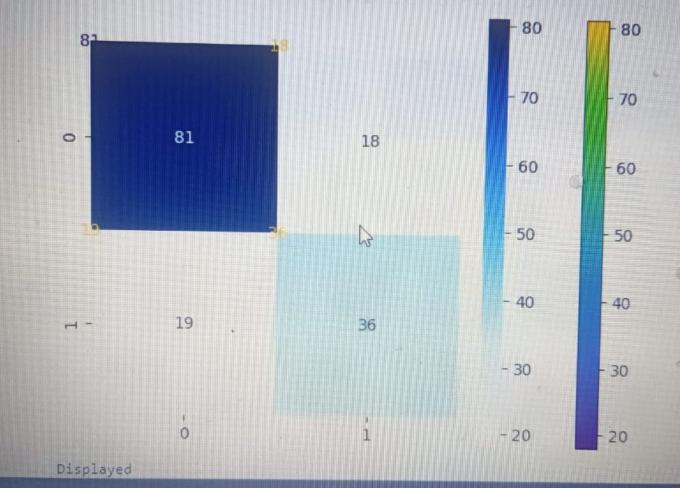
Confusion Matrix :

Slide 22
MODULE 2
PROGRAM :
import numpy as np
import pandas as pd
import matplotlib.pyplot as plt
import seaborn as sns
import warnings
warnings.filterwarnings("ignore", category=UserWarning)
from sklearn.model_selection import train_test_split
from sklearn.preprocessing import StandardScaler
from sklearn.svm import SVC
from sklearn.metrics import accuracy_score, classification_report, confusion_matrix
# Step 2: Load the dataset
df = pd.read_csv('/kaggle/input/diabetes-data-set/diabetes.csv')
# Step 3: Data Cleaning
# Check for Missing Values
missing_values = df.isnull().sum()
print("Missing Values:")
print(missing_values)

Slide 23
# Handle missing values (if any)
# For example, fill missing values with the mean of the column
mean_fill = df.mean()
df.fillna(mean_fill, inplace=True)
# Check for Duplicate Rows
duplicate_rows = df[df.duplicated()]
print("\nDuplicate Rows:")
print(duplicate_rows)
# Handle duplicate rows (if any)
# For example, drop duplicate rows
df.drop_duplicates(inplace=True)
# Step 4: Data Analysis
# Summary Statistics
summary_stats = df.describe()
print("\nSummary Statistics:")
print(summary_stats)
# Class Distribution (for binary classification problems)
class_distribution = df['Outcome'].value_counts()
print("\nClass Distribution:")
print(class_distribution)
# Step 5: Data Visualization
sns.pairplot(df, hue='Outcome')
plt.show()
# Step 6: Support Vector Machine (SVM) Modeling

Slide 24
# Separate features and target variable
X = df.drop('Outcome', axis=1)
y = df['Outcome']
# Split the dataset into a training and testing set
X_train, X_test, y_train, y_test = train_test_split(X, y, test_size=0.2, random_state=42)
# Standardize features
scaler = StandardScaler()
X_train = scaler.fit_transform(X_train)
X_test = scaler.transform(X_test)
# Initialize and train the SVM model
model = SVC(kernel='linear', random_state=42)
model.fit(X_train, y_train)
# Make predictions
y_pred = model.predict(X_test)
# Evaluate the model
accuracy = accuracy_score(y_test, y_pred)
print(f'Accuracy: {accuracy:.2f}')
# Classification report and confusion matrix
print(classification_report(y_test, y_pred))
cm = confusion_matrix(y_test, y_pred)
sns.heatmap(cm, annot=True, fmt='d')
plt.show()

Slide 25
OUTPUT :
Index: []
Summary Statistics:
Pregnancies Glucose BloodPressure SkinThickness Insulin \
count 768.000000 768.000000 768.000000 768.000000 768.000000
mean 3.845052 120.894531 69.105469 20.536458 79.799479
std 3.369578 31.972618 19.355807 15.952218 115.244002
min 0.000000 0.000000 0.000000 0.000000 0.000000
25% 1.000000 99.000000 62.000000 0.000000 0.000000
50% 3.000000 117.000000 72.000000 23.000000 30.500000
75% 6.000000 140.250000 80.000000 32.000000 127.250000
max 17.000000 199.000000 122.000000 99.000000 846.000000
BMI DiabetesPedigreeFunction Age Outcome
count 768.000000 768.000000 768.000000 768.000000
mean 31.992578 0.471876 33.240885 0.348958
std 7.884160 0.331329 11.760232 0.476951
min 0.000000 0.078000 21.000000 0.000000
25% 27.300000 0.243750 24.000000 0.000000
50% 32.000000 0.372500 29.000000 0.000000
75% 36.600000 0.626250 41.000000 1.000000
max 67.100000 2.420000 81.000000 1.000000
Class Distribution:
Outcome
0 500
1 268
Name: count, dtype: int64

Slide 26
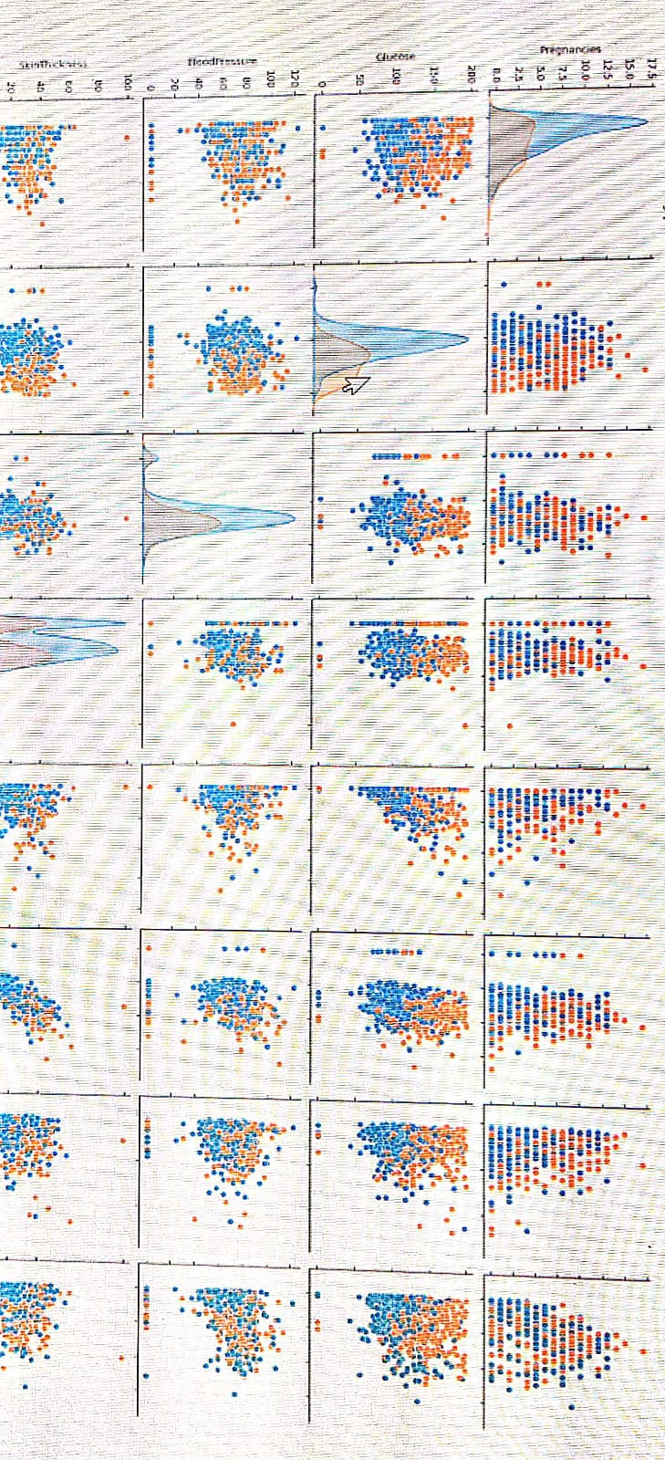

Slide 27
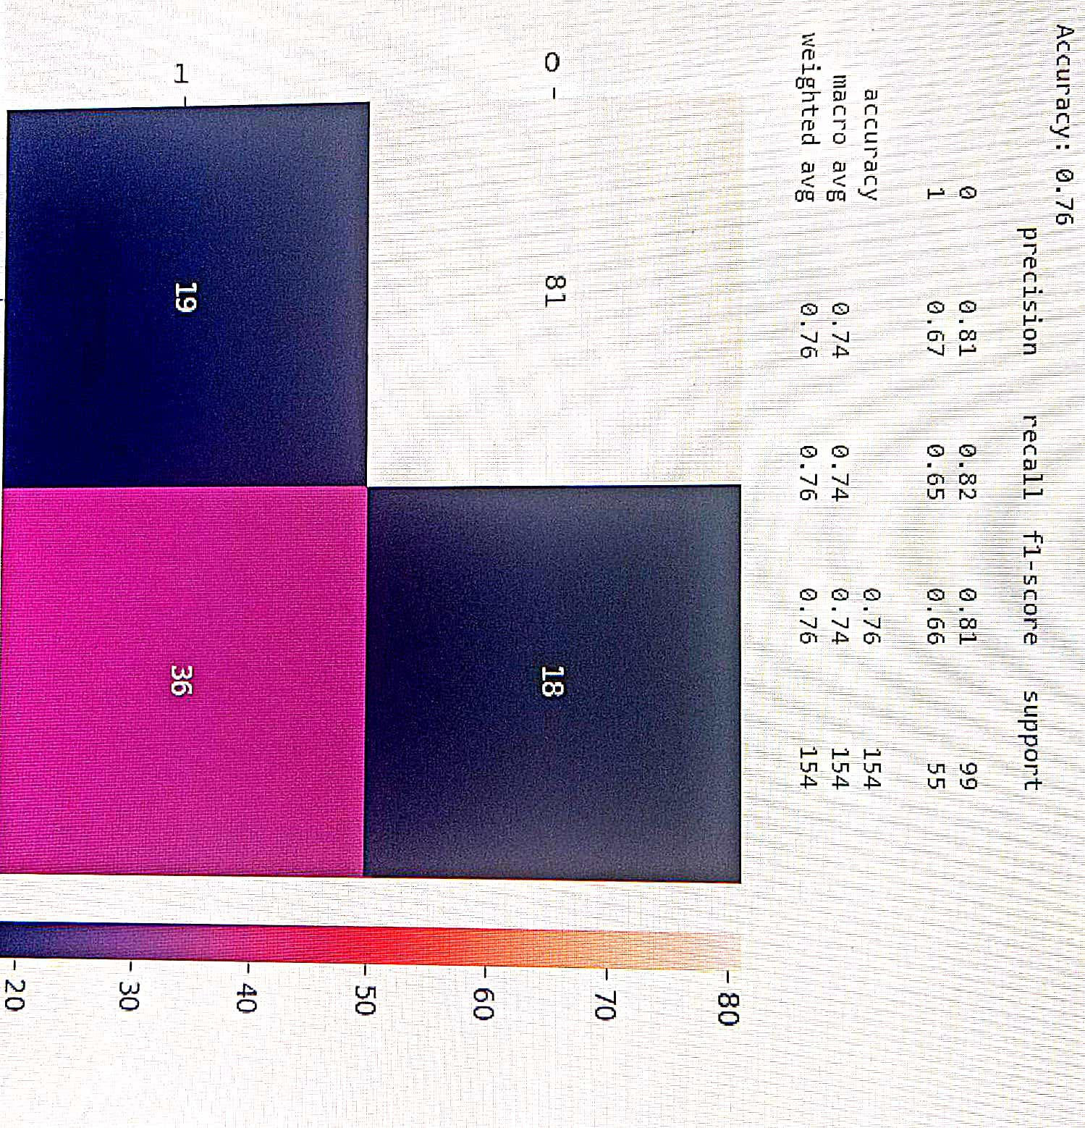

Slide 28
INTEGRATION APPROACH
Data Integration:Gather patient data from electronic health records (EHRs), wearable devices, or other sources. Ensure data is standardized and accessible for AI processing.
Data Preprocessing:Clean and preprocess incoming data to handle missing values, outliers, and ensure data quality
API or SDK Development:Develop an API or SDK that encapsulates the AI-based diabetes prediction model. This allows other healthcare systems or applications to interact with the prediction service.
Secure Data Transmission:Implement encryption and secure data transmission protocols (e.g., HTTPS) to protect patient data during transfer to and from the AI service.
Authentication and Authorization:Implement robust authentication and authorization mechanisms to control access to the AI prediction service, ensuring only authorized users can make predictions
Real-time or Batch Integration:Choose between real-time and batch processing based on the application's requirements. Real-time integration may involve continuously sending and receiving data, while batch integration processes data periodically.

Slide 29
INTEGRATION APPROACH
Mobile Apps:
Project Planning:Define the objectives and scope of the app.Identify the target audience (patients, doctors, caregivers).Decide whether the app will be for iOS, Android, or both (cross-platform).
Data Collection:Gather relevant medical data (e.g., glucose levels, patient history) either through manual input or integration with wearables or EHRs
AI Model Integration:Integrate the AI-based diabetes prediction model into the app. You can use machine learning frameworks like TensorFlow, PyTorch, or pre-trained models.
User Authentication and Security:Implement secure user authentication to protect sensitive medical data.Ensure compliance with healthcare data privacy regulations like HIPAA or GDPR
User Interface (UI) Design:Design a user-friendly and intuitive interface.Include features for data input, viewing predictions, and accessing historical data.Prioritize accessibility features for users with disabilities.
Real-time Data Handling:If the app involves real-time data, implement data streaming or periodic updates from wearables or sensors.

Slide 30
BENEFITS
Early Detection: AI can analyze patient data to identify early signs of diabetes or prediabetes, allowing for timely intervention and lifestyle changes to prevent or delay the onset of the disease.
Improved Patient Care:Personalized Recommendations: AI can provide personalized recommendations for diet, exercise, medication, and lifestyle modifications based on individual patient data.
Enhanced Monitoring: Patients can use AI-powered apps or devices to monitor their glucose levels, receive alerts, and track trends, leading to better self-management
Risk Assessment:Accurate Risk Assessment: AI models can accurately assess a patient's risk of developing diabetes, helping healthcare professionals prioritize high-risk individuals for preventive measures.
Efficient Healthcare Delivery:Resource Allocation: Healthcare providers can allocate resources more efficiently by focusing on patients at higher risk, reducing the burden on healthcare systems.Telemedicine: AI-powered diabetes prediction systems can support telemedicine by remotely monitoring patients and facilitating virtual consultations.
Reduced Healthcare Costs:Preventive Care: Early intervention and preventive strategies can reduce the long-term healthcare costs associated with diabetes complications.Fewer Hospitalizations: Better management and early detection can lead to fewer hospital admissions and emergency room visits.

Slide 31
THANK YOU

